Slide 1
Zephyrus – Cloud & Task Management Tool
^{Oscar E. Ganteaume}
^{November 2018}

Slide 2
Zephyrus – Cloud & Task Management Tool
The Problem with AWS Costs
Amazon Web Services (AWS’ C2S) provides an excellent cloud infrastructure solution for government enterprises.
  The good news is that AWS is a pay-per-use service, provides universal access to state-of-the-art computing resources, and scales with the growing needs.
  The bad news – AWS mission costs have shown that they far exceed the costs of dedicated stovepipe system costs
    Routine Provisioning of instances for a worst case scenario
    The Elastic Compute cloud (EC2) is charged per usage time even if the EC2 instance is using less than destined capacity or sitting idle.
    Limited Mission Resource Visibility
LGS Innovation has developed, and has a patent pending on technology that will save up to 50% of the AWS compute costs within C2S, DI2E, and GovCloud by dynamically “Right-Sizing” resources & providing visibility in a Cloud agnostic environment

Slide 3
Zephyrus – Cloud & Task Management Tool
Main Objectives
Resource Management
  The Auto Scaling engine analyzes performance metrics and determines when to start or stop virtual machines using cloud services provided API
  Allows customer to add their own resource allocation algorithm through an application programming interface
  Service is cloud provider agnostic and compatible with major cloud providers
  It uses its own algorithms and allows developers to create their own as well, to decide how the tasks need to be allocated (Load Balancing).
  Provides cluster status through a web-based dashboard monitoring application
  Monitors the resources utilization such as memory, CPU, disk space, number of tasks running, (Visibility).
Tasks Management
  Capable of running on two different modes:
    Conventional mode
    Serveless mode
  Allows users to add, modify, remove custom tasks to generate processing threads through a web-based GUI
  Allows user to start, stop, pause processing threads through a web-based GUI
  Allows incorporation of external frameworks such as NiFi to interact with framework
  Facilitates Big Data Processing by incorporating frameworks such as Hadoop and Spark

Slide 4
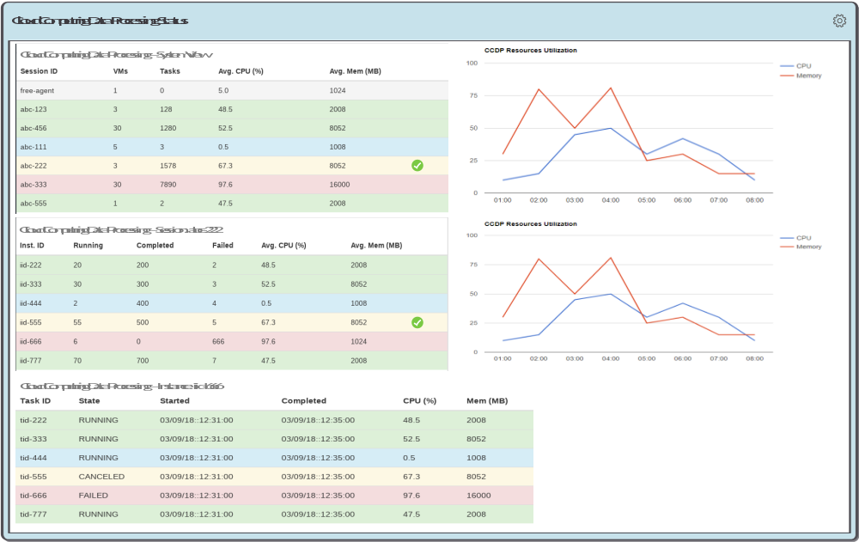
Zephyrus – Cloud & Task Management Tool
Resources Allocation View

Slide 5
Zephyrus – Cloud & Task Management Tool
Benefits
Could reduce operation costs significantly based on the actual processing resources needs by:
  Stopping resources that are not being used
  Provides running mode options allowing customers to choose best running mode
Simplifies the configuration and management of a cluster
  Removes the need to know how to use cloud provider’s resource management which could be very difficult and convoluted
Provides a more flexible resource allocation schemes through API
Simplifies integration with widely used processing frameworks
Simplifies custom processing needs through the framework’s API

Slide 6
Zephyrus – Cloud & Task Management Tool
Actual Cost Comparison
Chauee Typical Usage Scenario
Service | Legacy Cost | 7H Cost
EC2 | $9,876.84 | $3,567.25
RDS | $0.00 | $556.32
Total Equiv. Monthly | $9,876.84 | $4,123.57
Sixty Users Eight Hours Shift Monthly Cost
Service | Legacy Cost | 7H Typical Cost | 7H Max Cost (*)
EC2 | $6,449.74 | $3,035.56 | $4,659.24
EBS | $515.29 | $403.37 | $403.37
RDS | $0.00 | $365.38 | $365.38
Total Monthly | $6,965.03 | $3,804.31 | $5,427.99
(*) Running all necessary instances 100% of the time due to support requirements

Slide 7
Zephyrus – Cloud & Task Management Tool
Future Investment
Mature prototype for a production environment
  Perform code review
  Add more formal testing procedures
  Add unittesting
  Perform stress testing
  Improve build system
Replace current configuration approach
Develop configuration page
Replace current heartbeat monitoring/reporting approach
Improve task and thread management web based tool

Slide 8

Zephyrus – Cloud & Task Management Tool
Additional Questions
Questions?
Oscar E. Ganteaume
Office: 703.665.7259
Cell: 703.655.3479
Oganteaume@LGSInnovations.com

